Slide 1
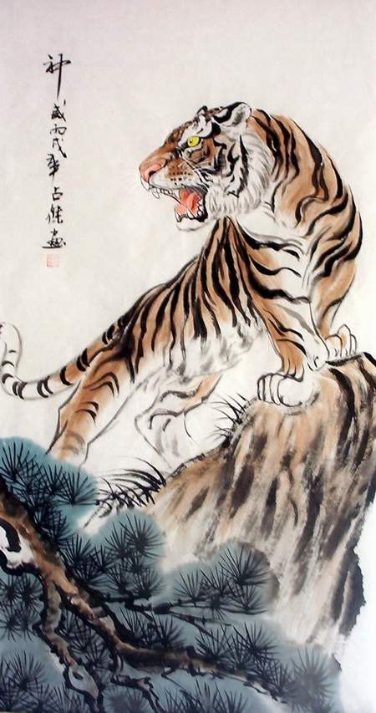
The Jungle Game
Chesshire Coders
Angélica Fallas
Taner King
Adam Gundem
Alexander Hennings
Cameron Ackerman
Image from: http://www.tattoodaze.com/tattoo-images/79/th_tiger-art-decor-mountain-tiger-tiger-hand-painting-original-bkLbwV.jpg

Slide 2
Presentation Overview
Changes from last iteration
Sequence diagrams
Class diagrams
Test Case Summary
Project Tools
Traceability Matrix & Use Case Progress
Demo

Slide 3
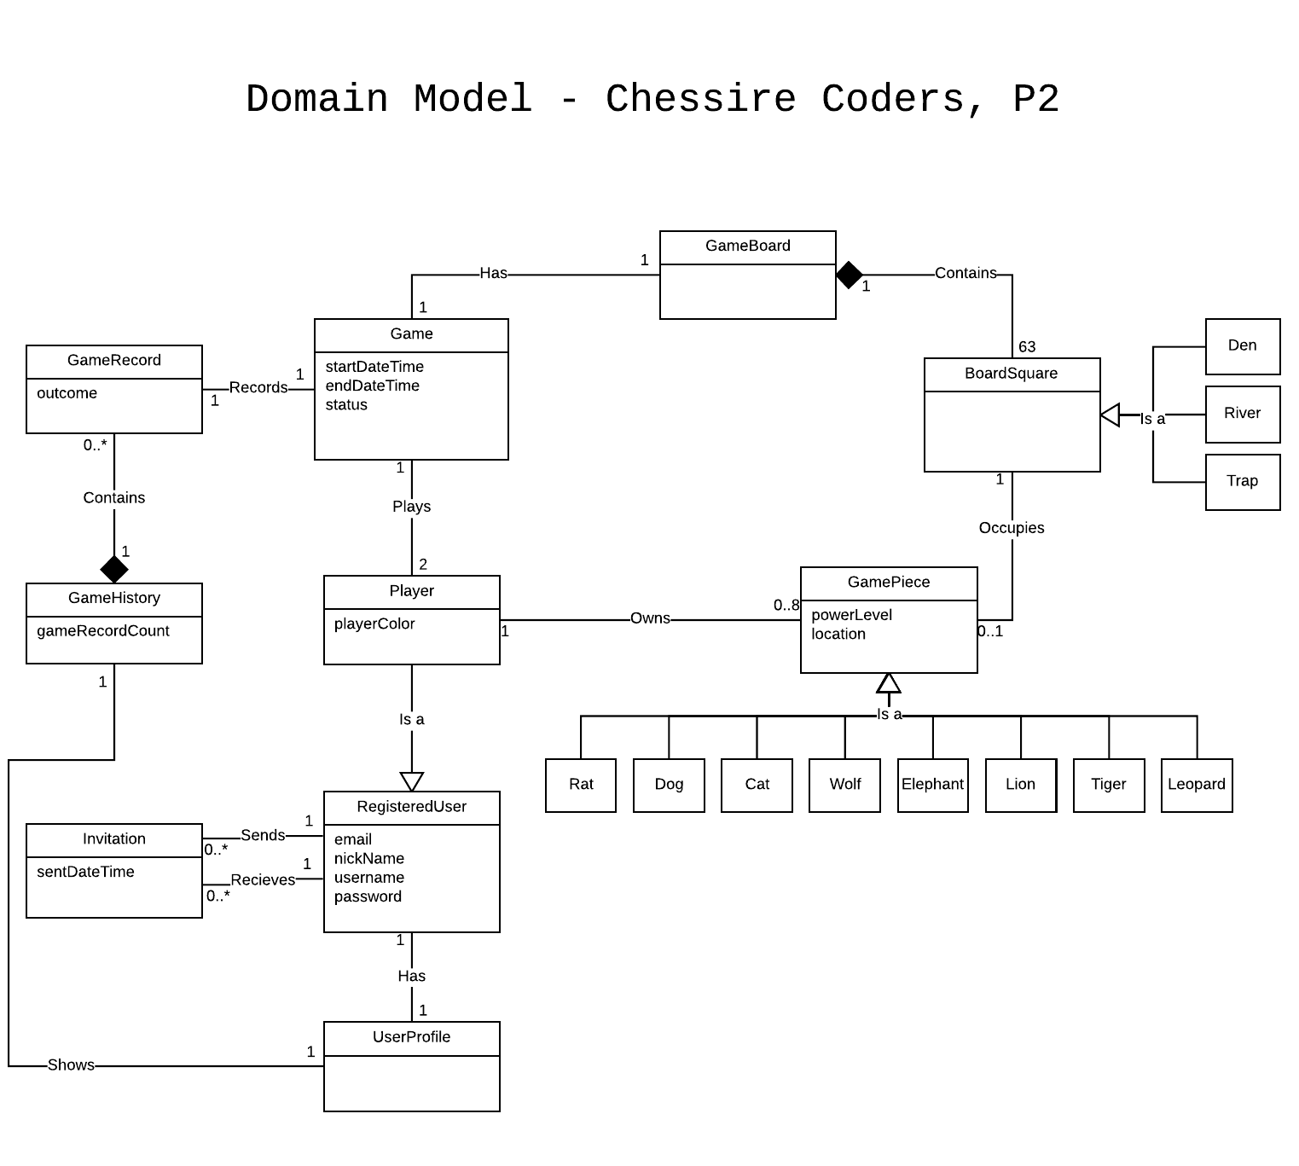
Domain Model Changes
Removed piece from BoardSquare and players from Game.

Slide 4
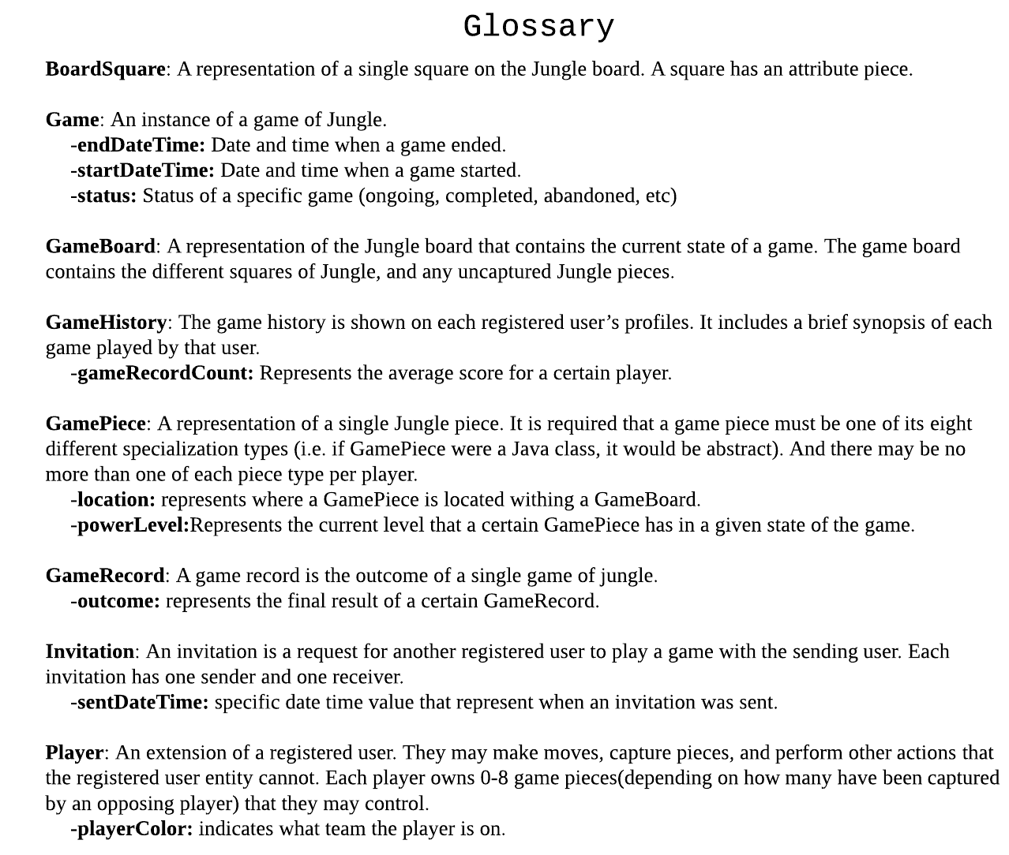
Glossary Changes
Added entries for attributes.
Sorted items alphabetically.

Slide 5
Sequence diagrams
Login
Game Invite
Game Create
Register

Slide 6
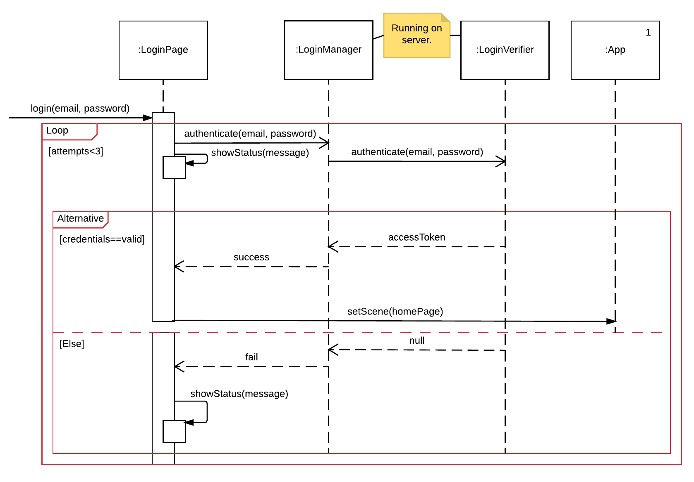
Login

Slide 7
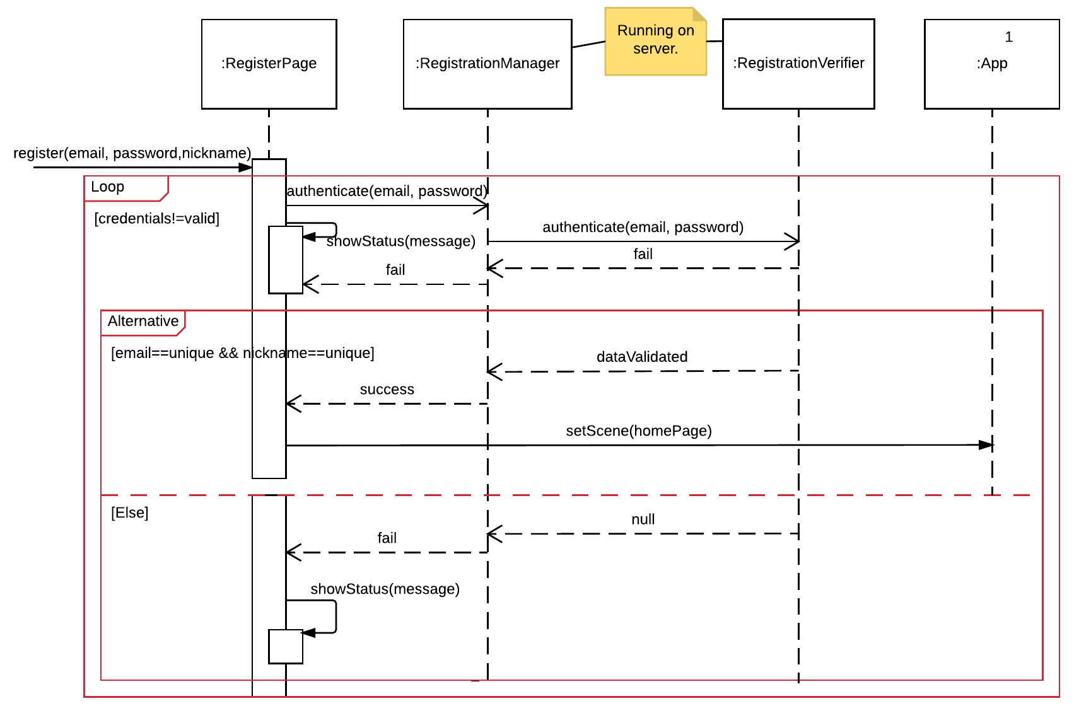
Register

Slide 8
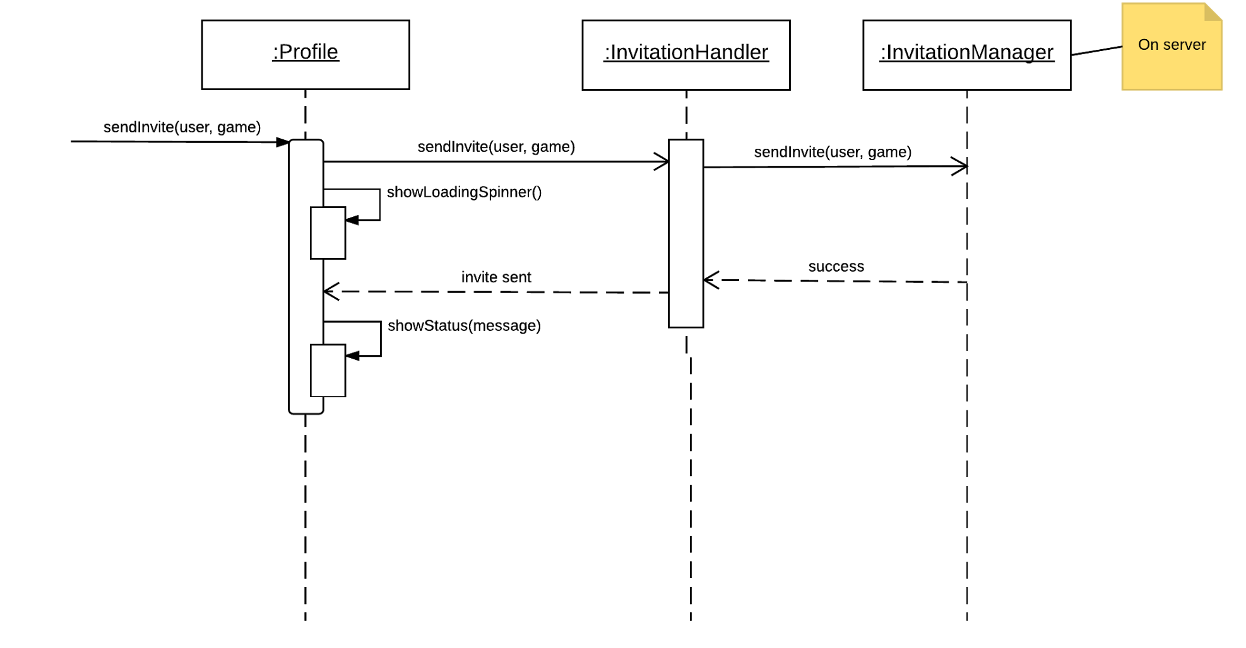
Game Invite

Slide 9
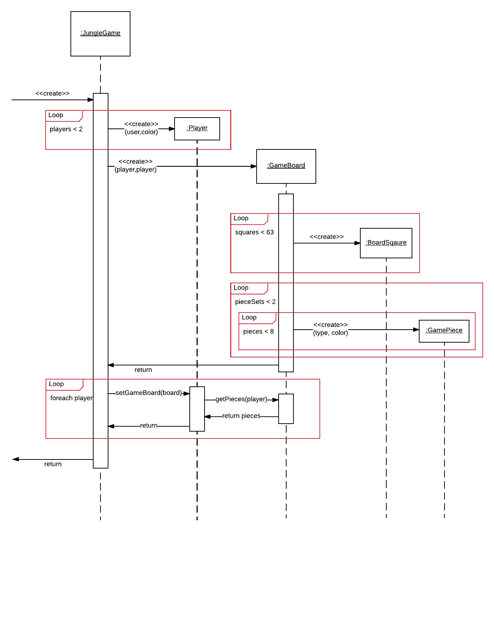
Create Game

Slide 10
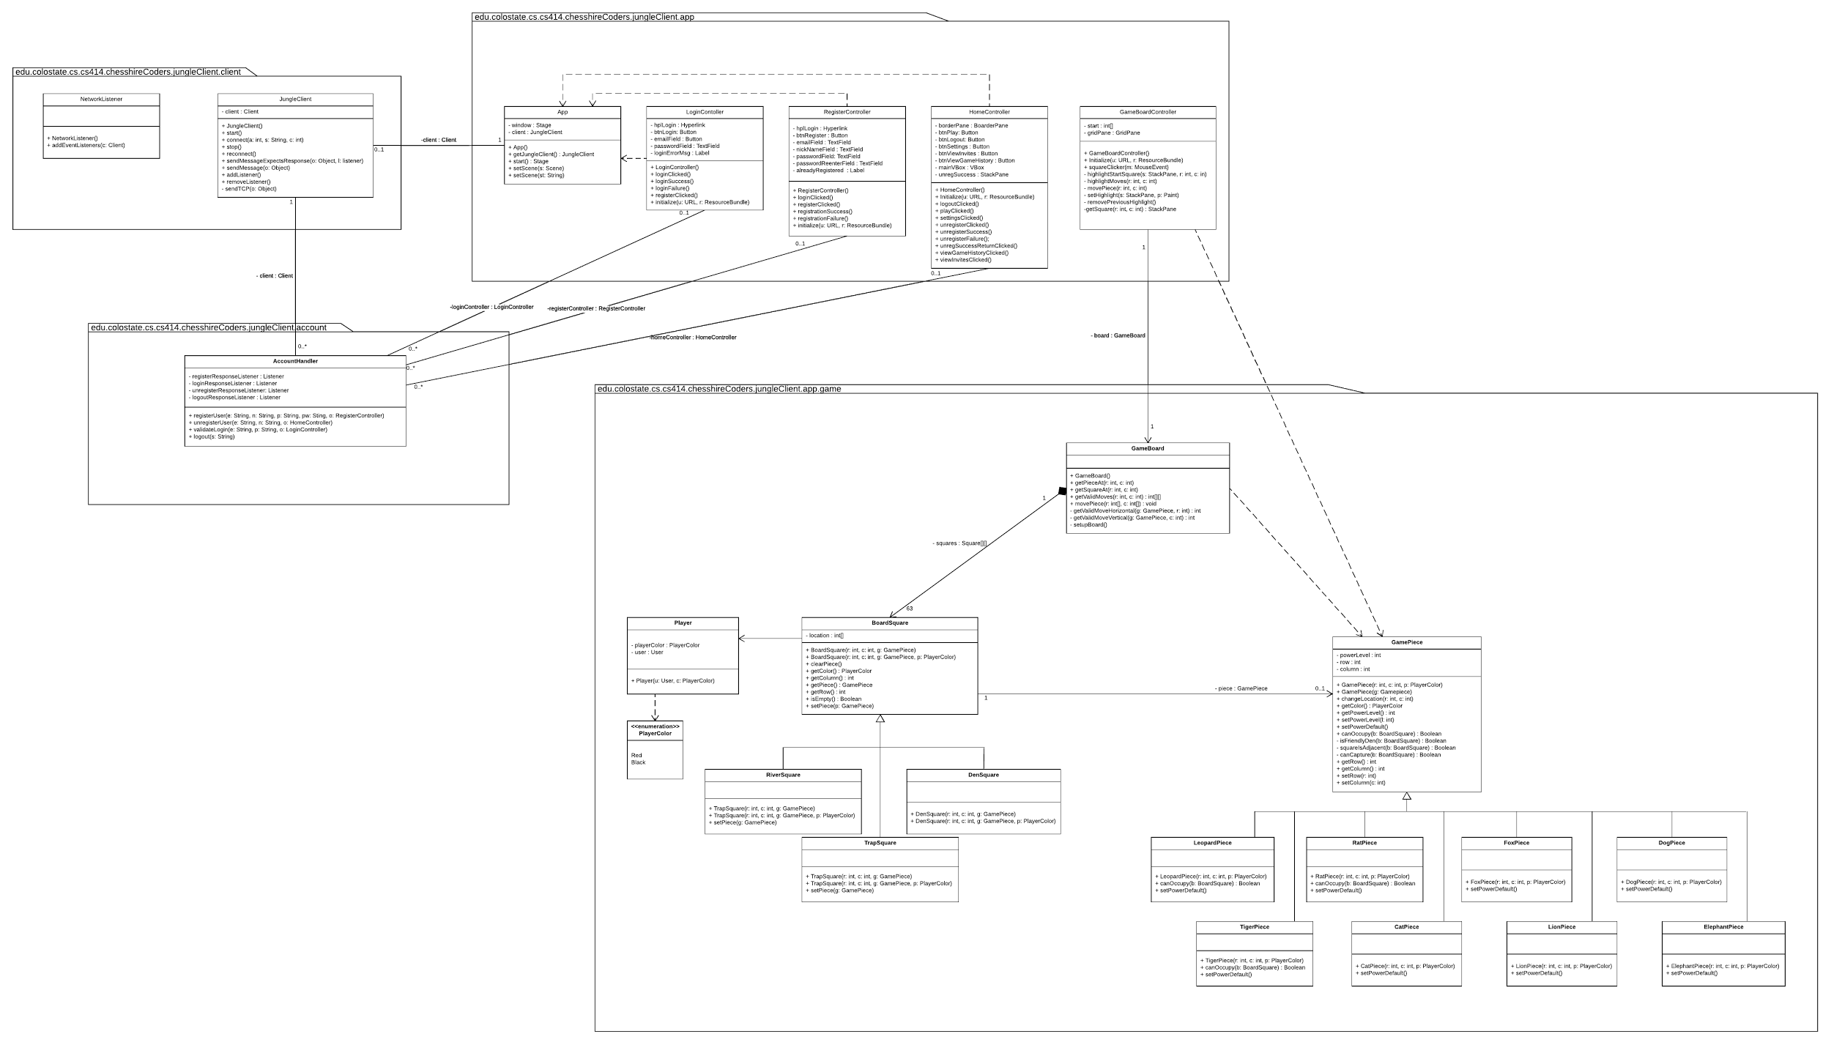
Class Diagram
Client Logic - Overview

Slide 11
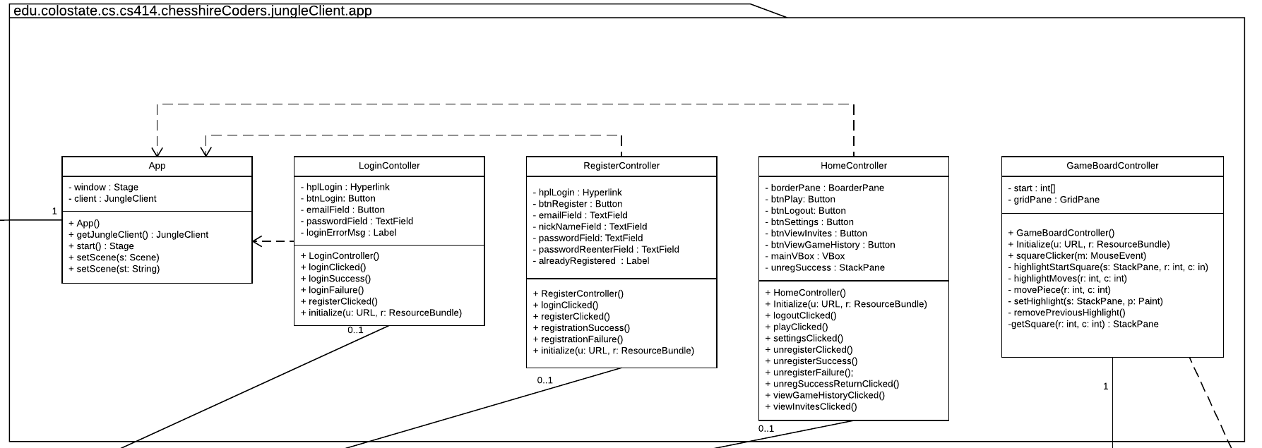
Class Diagram
Client Logic

Slide 12
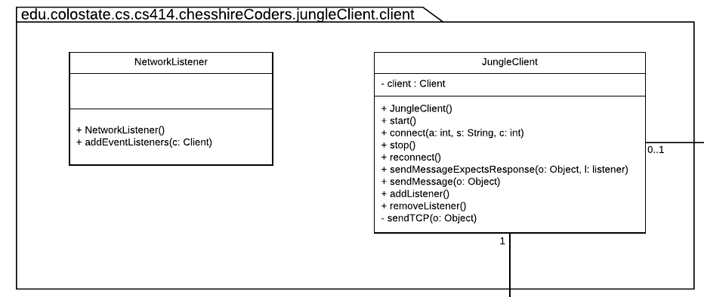
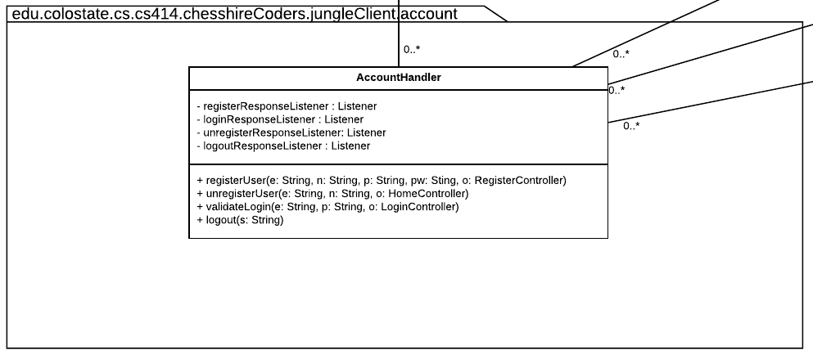
Class Diagrams - Client cont.
-client : Client

Slide 13
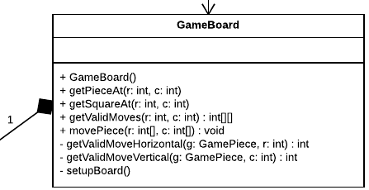
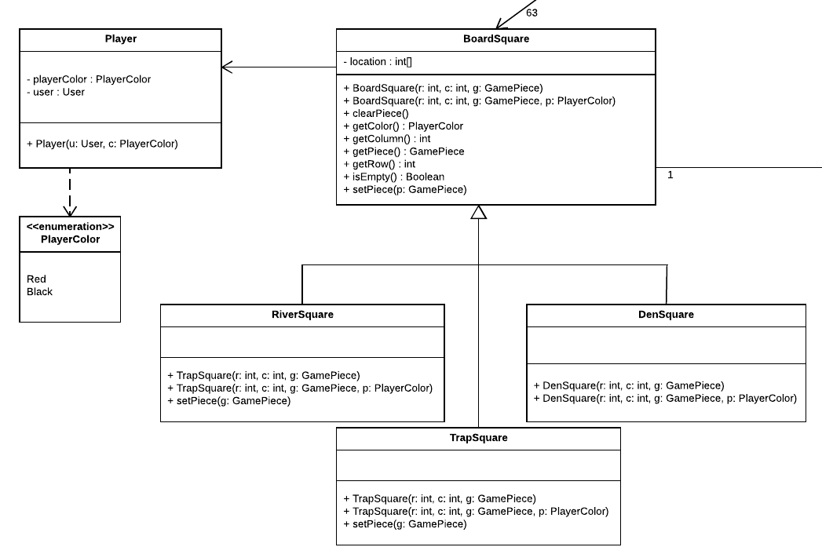
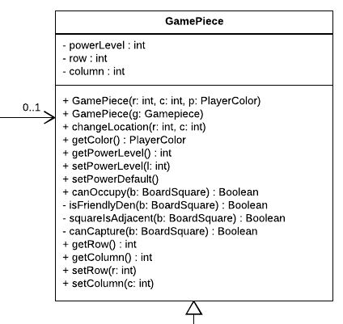
Class Diagram
Game Logic

Slide 14
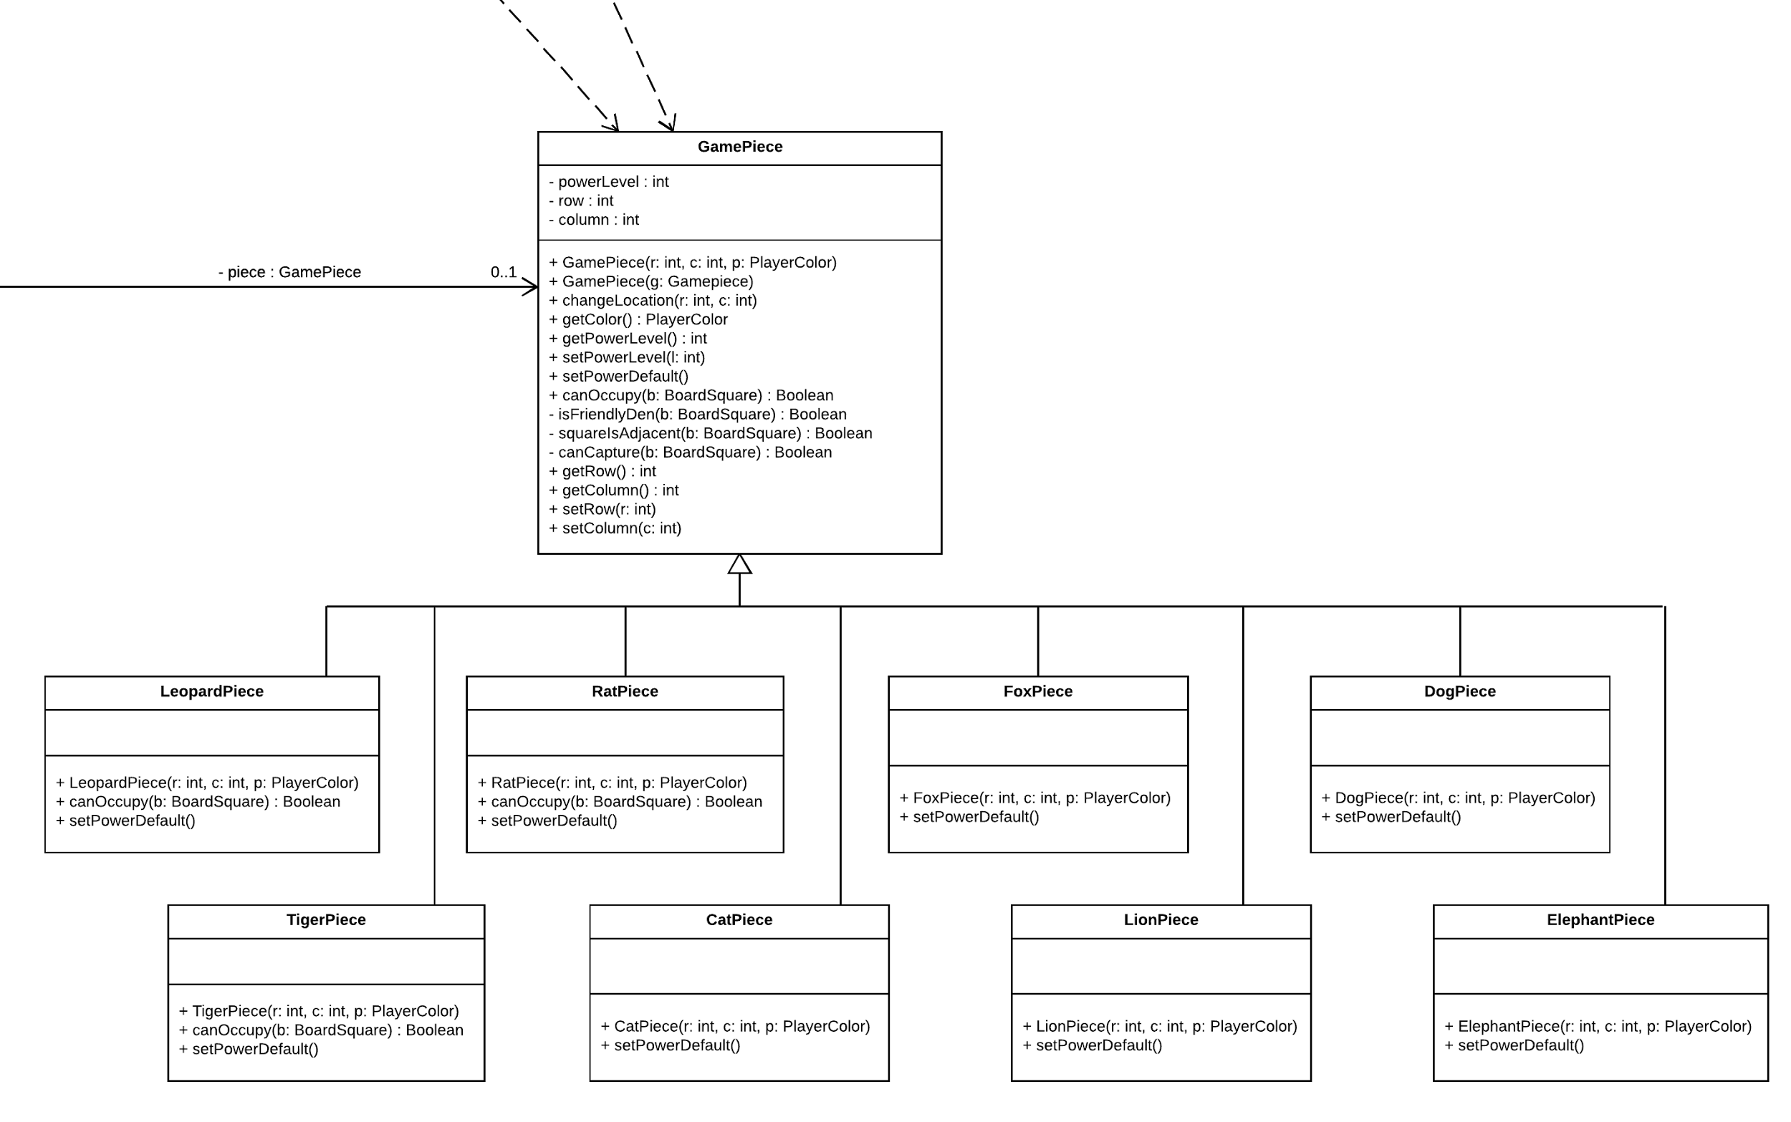
Class Diagram
Game Logic - Cont.

Slide 15
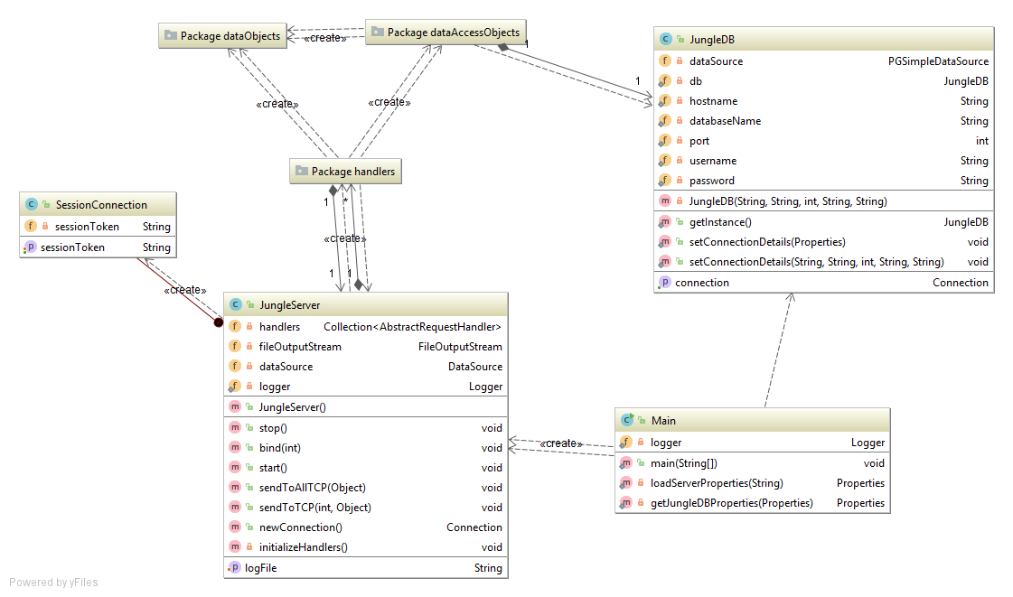
Class Diagrams - Server
Notes:
JungleDB is a singleton.

Slide 16
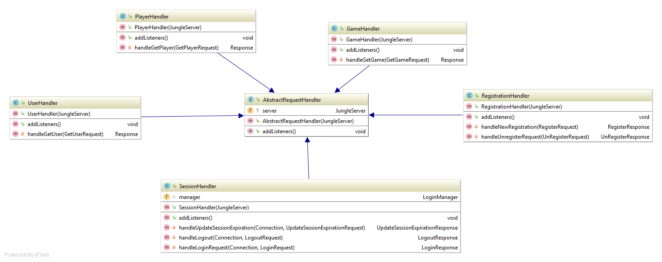
Class Diagrams - Server cont.
Handlers

Slide 17
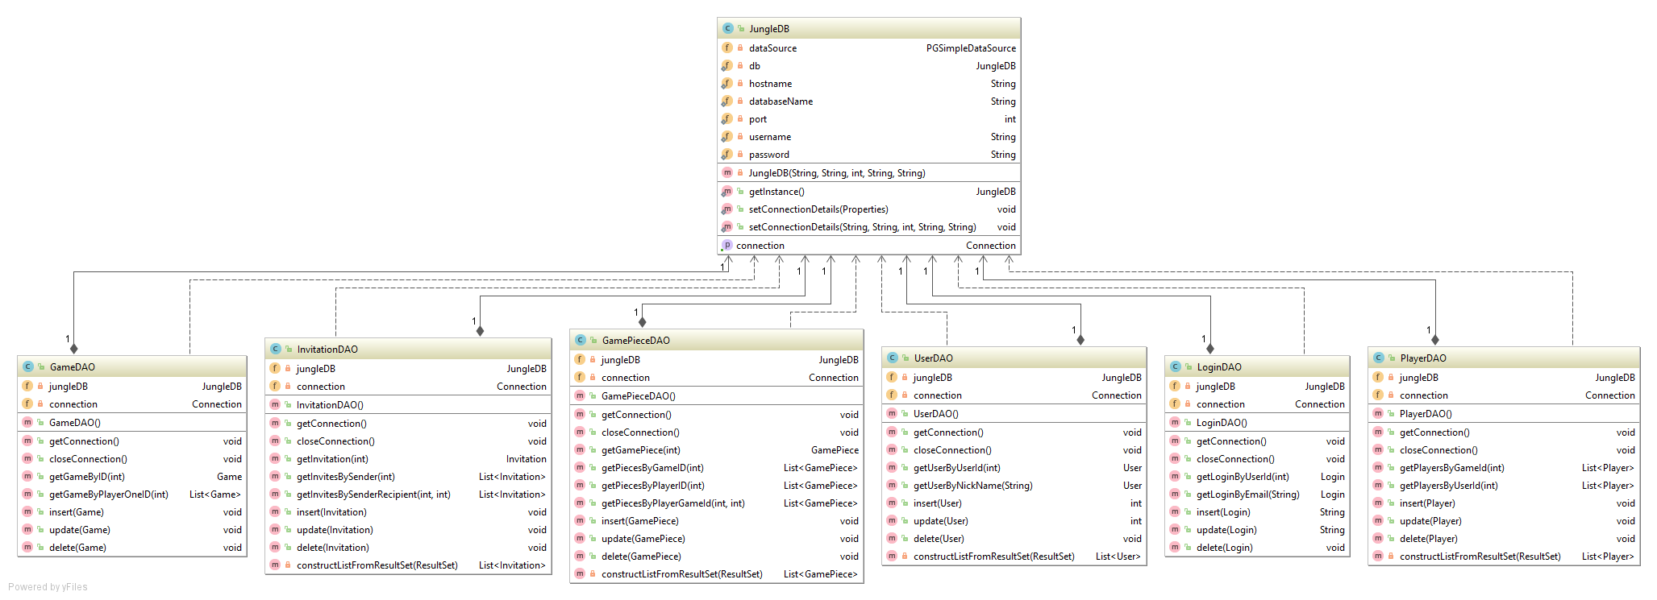
Class Diagrams - Server cont.
Data Access Objects

Slide 18
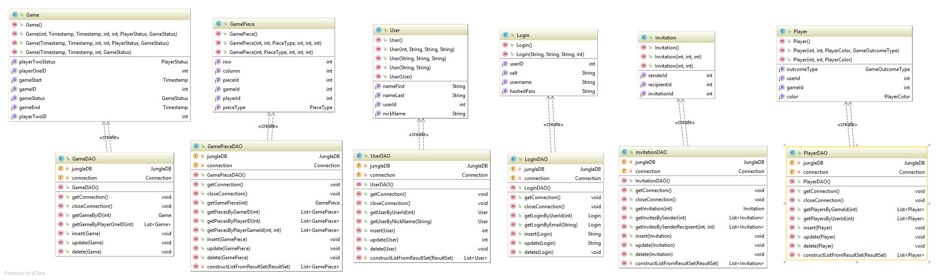
Class Diagrams - Server cont.
Data Objects/Data Access Objects

Slide 19
Test Case Summary
TestBoardSquare: 16 tests
TestGameBoard: 15 tests
TestAccountHandler: 6 tests
TestBoardSquare: 6 tests

Slide 20
Project Tools
Development Tools | Libraries & Frameworks | Other
Eclipse IntelliJ IDEA Gluon Scene Builder Maven Git & Github Lucidchart | JavaFX Mockito JUnit KryoNet | DigitalOcean Cloud Hosting PostgreSQL Docker Slack Waffle.io Travis CI

Slide 21
Traceability Link Matrix
 | Game | Game Piece | Invitation | Login | Player | User | Jungle Game | Board Square | Game Board
#1: Register to the system |  |  | x | x |  | x
#2: Create a new game | x |  | x | x |  |  |  |  | x
#3: Invite other users to a game | x |  | x | x
#4: Respond to Game Invitation | x |  | x | x | x |  |  |  | x
#5: Quit Game | x |  |  | x | x |  |  |  | x
#6: Unregister from System |  |  |  | x |  | x
#7: View Player Profile |  |  |  | x | x
#8: Log in to System |  |  |  | x |  | x
#9: Log out of System |  |  |  | x |  | x
#10: Move Game Piece |  | x |  | x | x |  |  | x | x
#11: Switch Game | x |  |  | x | x |  |  |  | x

Slide 22
Use Case Completion
Use Case | Progress Notes
#1: Register to the system | Most server-side logic in place, validation, redirection to new pase
#2: Create a new game | Client and GUI logic completed.
#3: Invite other users to a game | Data objects and network handlers in place.
#4: Respond to Game Invitation | Server configuration ready to handle invite send/receive events
#5: Quit Game | Game logic functional, working on server implementation.
#6: Unregister from System | GUI elements done, some server side logic in place
#7: View Player Profile
#8: Log in to System | GUI elements done, server logic in place
#9: Log out of System | GUI elements done, server logic in place
#10: Move Game Piece | GUI and client logic done, some server logic in place
#11: Switch Game | Basic logic in place, working on server side information

Slide 23
Demo

Slide 24
Questions
And
Discussion

